Slide 1

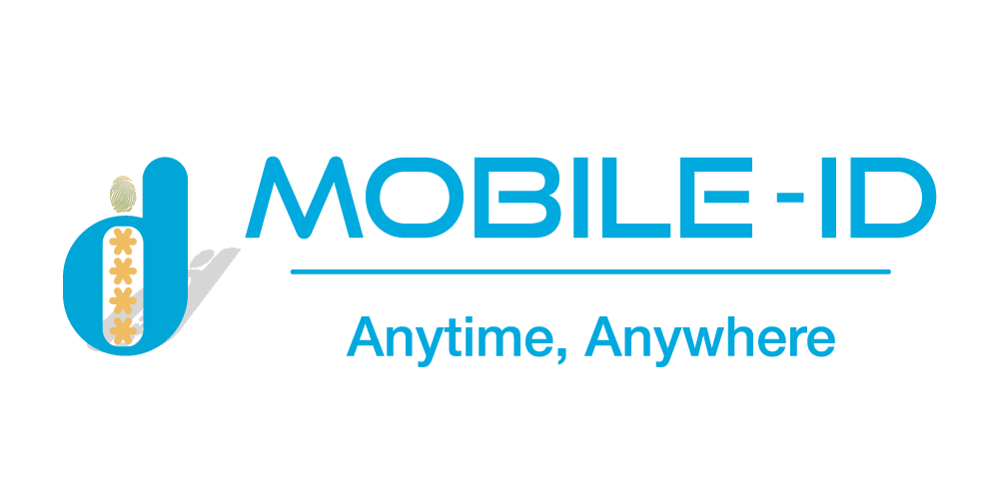

OVERVIEW
GOPAPERLESS
Online identity verification and signing platform with full optimal features

Slide 2




CONTENTS
GOPAPERLESS SYSTEM OVERVIEW
GOPAPERLESS SUBSYSTEM

Slide 3

INTRODUCTION
PURPOSE
OVERVIEW
To save time, and costs, increase the ability to manage, store, and secure information, digital transformation is indispensable and “Electronic identity” is also a necessary need today.
It can be seen that to sign a contract, financial report, etc., verifying personal identity and legal signature using a manual process will require many procedures, time and cost. From the above issue, the GoPaperless electronic identification and signing platform was born so that simplifies a paperless document signing process.
At GoPaperless, all e-signatures are created using high-assurance eIDs and meet the strictest requirements set forth under the EU eIDAS regulation.
Create an online signing and verifying identity platform with all of the optimal features, specifically:
GOPAPERLESS SYSTEM
Enables quick, efficient online approval of any business document, agreement, report, request, or package;
Cuts time, reduces costs and adds strong controls to minimize signing errors;
Ensure traceability, accountability and audit with clear legal weight, data integrity and individual signed approval together with easy to access workflow process evidence;
Can be shared, viewed, and signed on any device, anywhere, anytime in a way that suits any approval process.

Slide 4












OVERVIEW GOPAPERLESS SYSTEM
Equal to handwritten signatures
Tamper-proof documents
Legally binding
Real e-signatures
Supported Qualified Electronic Signatures are equal to handwritten signatures
All documents signed in GoPaperless are secured against forgery and backdating
Supported e-signatures are legally binding and accepted across the entire Vietnam
Electronic signatures are not scribbled images on a document
Customer
Strengths
Integrated model
Model deployment
Wide customer base: Bank, telecommunications, etc.
Connect to many CA providers, types of digital signatures
Use API or iFrame, speed up integration and easy of maintenance
Can be On – Premise to protect information for end customers

Slide 5











FEATURES OF GOPAPERLESS SYSTEM
Variety of document formats
Variety of signing
solutions
Signature validation
Address book and
contact categories
Sign documents in whatever format you need — from PDF
Sign documents with your preferred eID solution, whether it’s a national ID card, Mobile ID or other
Check whether signatures from other parties are valid and legally binding
Save contacts to an address book to easily find them next time you need to share a document
Search and filter
Comments
Batch actions
Secure sharing
Filter documents by categories and search to quickly find what you are looking for
Discuss important topics and leave notes for other signing parties
Sign, delete or download all selected documents with just one click from a single location
Only intended persons who authenticate with an eID matching that person can access documents
Multilingual interface
Automatic notifications
Audit trail
Use GoPaperless in English, Vietnamese. More languages coming soon
Get informed when your signature is needed or when other parties have signed the document
See all actions performed by the users through a detailed list of events

Slide 6







FEATURES FOR TEAM
Smooth and organized document signing process
Easy and orderly document management
Approvals
Document categories
Add additional consents to the documents to make sure they are viewed and confirmed by the responsible person before signing
Sort documents into categories for a more convenient and orderly experience
Workflows
Permissions based on categories
Create a sequence of actions for every signing party to make sure the document signing process is well-rounded and in order
Manage user rights to edit, share or delete documents assigned to categories
Deadlines and reminders
User roles
Set deadlines and additional reminders to make sure other parties sign
on time
Apply different roles for users: they have to sign a document or can only view it
All your company data at your fingertips
Company data
Centralized billing
Separate Accounts
Easily manage accounts of your team members and document access rights using centralized controls to make sure sensitive documents stay in the right hands
Reduce time spent on paying separate invoices. You can give each team member their own GoPaperless account, and pay for everything with a single invoice
Use different accounts for company and private purposes in order to separate document ownership, intended usage and costs.

Slide 7


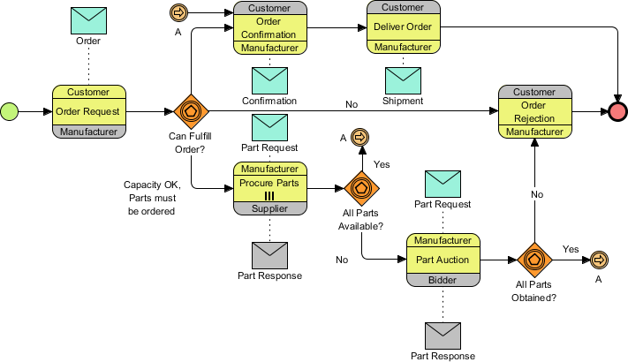
OVERVIEW
GOPAPERLESS SYSTEM ARCHITECTER
External System
Bank, judicial, etc.
Business
Mobile-ID’s Internal System
CUSTOMER
eTax, eContract, eInvoice, Qrypto, CheckID, eKYC, etc.
Personal
Mobile-ID’s staff
Sales, Admin, customer support staff, etc.

Slide 8






IDENTIFICATION
PLATFORM
PERSONAL IDENTITY
BUSINESS IDENTITY
STEP 1
STEP 2
STEP 3
Face authentication
4 factors authentication
via Finance
3 factors authentication
via service provider
Verify business
Representative information
Check company
information
Authorization
authentication
Check Liveness
Compare with portrait photo
Compare with Citizen Identity cards
Verify national data
Check full name
Check ID Card/ Citizen ID card number Check financial status
Check taxpayer status
Check full name
Check ID Card/ Citizen ID card number
Check phone number
Face authentication
4 factors authentication via finance
3 factors authentication via service provider
Company’s name
Company registration certificate number
Information on company status
Authorization legal representation
Sesame enterprise certification?
Deposit money into company account?

Slide 9

FULL PROCESS SIGNING PLATFORM
Service Provider
Signer
Verify identity
Confirm contract
Sign
Digital
contact
Authenticate
Manage contact
Electronic deposit
Legal service
Verify individuals
Verify enterprise
Ensure the accuracy of identity information by using services such as eKYC, OTP, etc.
Sign: Ensure the signer’s wishes via letter of commitment, confirmation
Deploy electronic contract on industries ecosystem platform: Banking, Electronic Commercial, Real Estate, Automotive, etc.
Template of contract, condition Monitor contract
Provide deposit, certificate of deposit service Notarize, authenticate contract

Slide 10

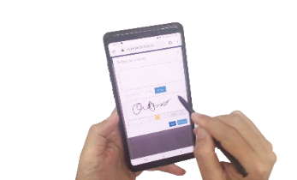

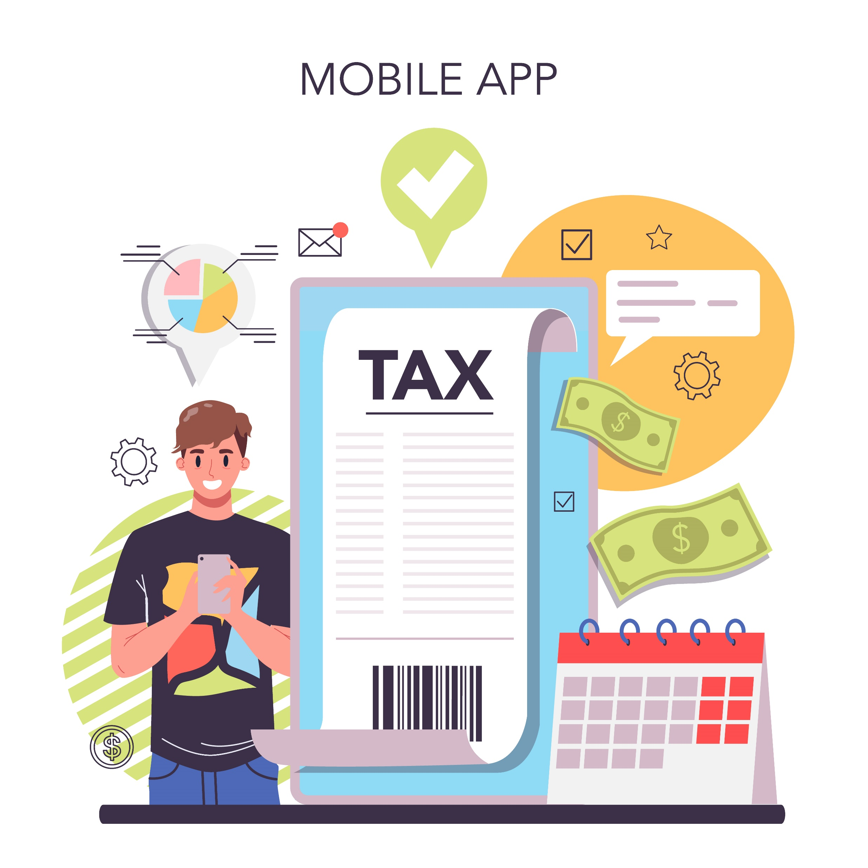



EXAMPLE OF A CAR, MOTORBIKE TRADING APPLICATION PLATFORM
Prepare electronic loan documents
Verify, issue digital certificate and sign contract/document
Bank staff check electronic documents
Agency issue invoice and certificate to declare tax
Sign credit contract, insurance/debit certificate with bank
Bank disbursement. Customer signs receipt record and receives vehicle
Police department check credit contract when vehicle is used

Slide 11

GOPAPERLESS
SUBSYSTEM

Slide 12

eRequest
eFlow
GOPAPERLESS SUBSYSTEM
eAnalysis
eProcess
eID
Virtual Collaboration
GOPAPERLESS
eBilling
eRegistry
eWriter
eAccount
eNotary

Slide 13
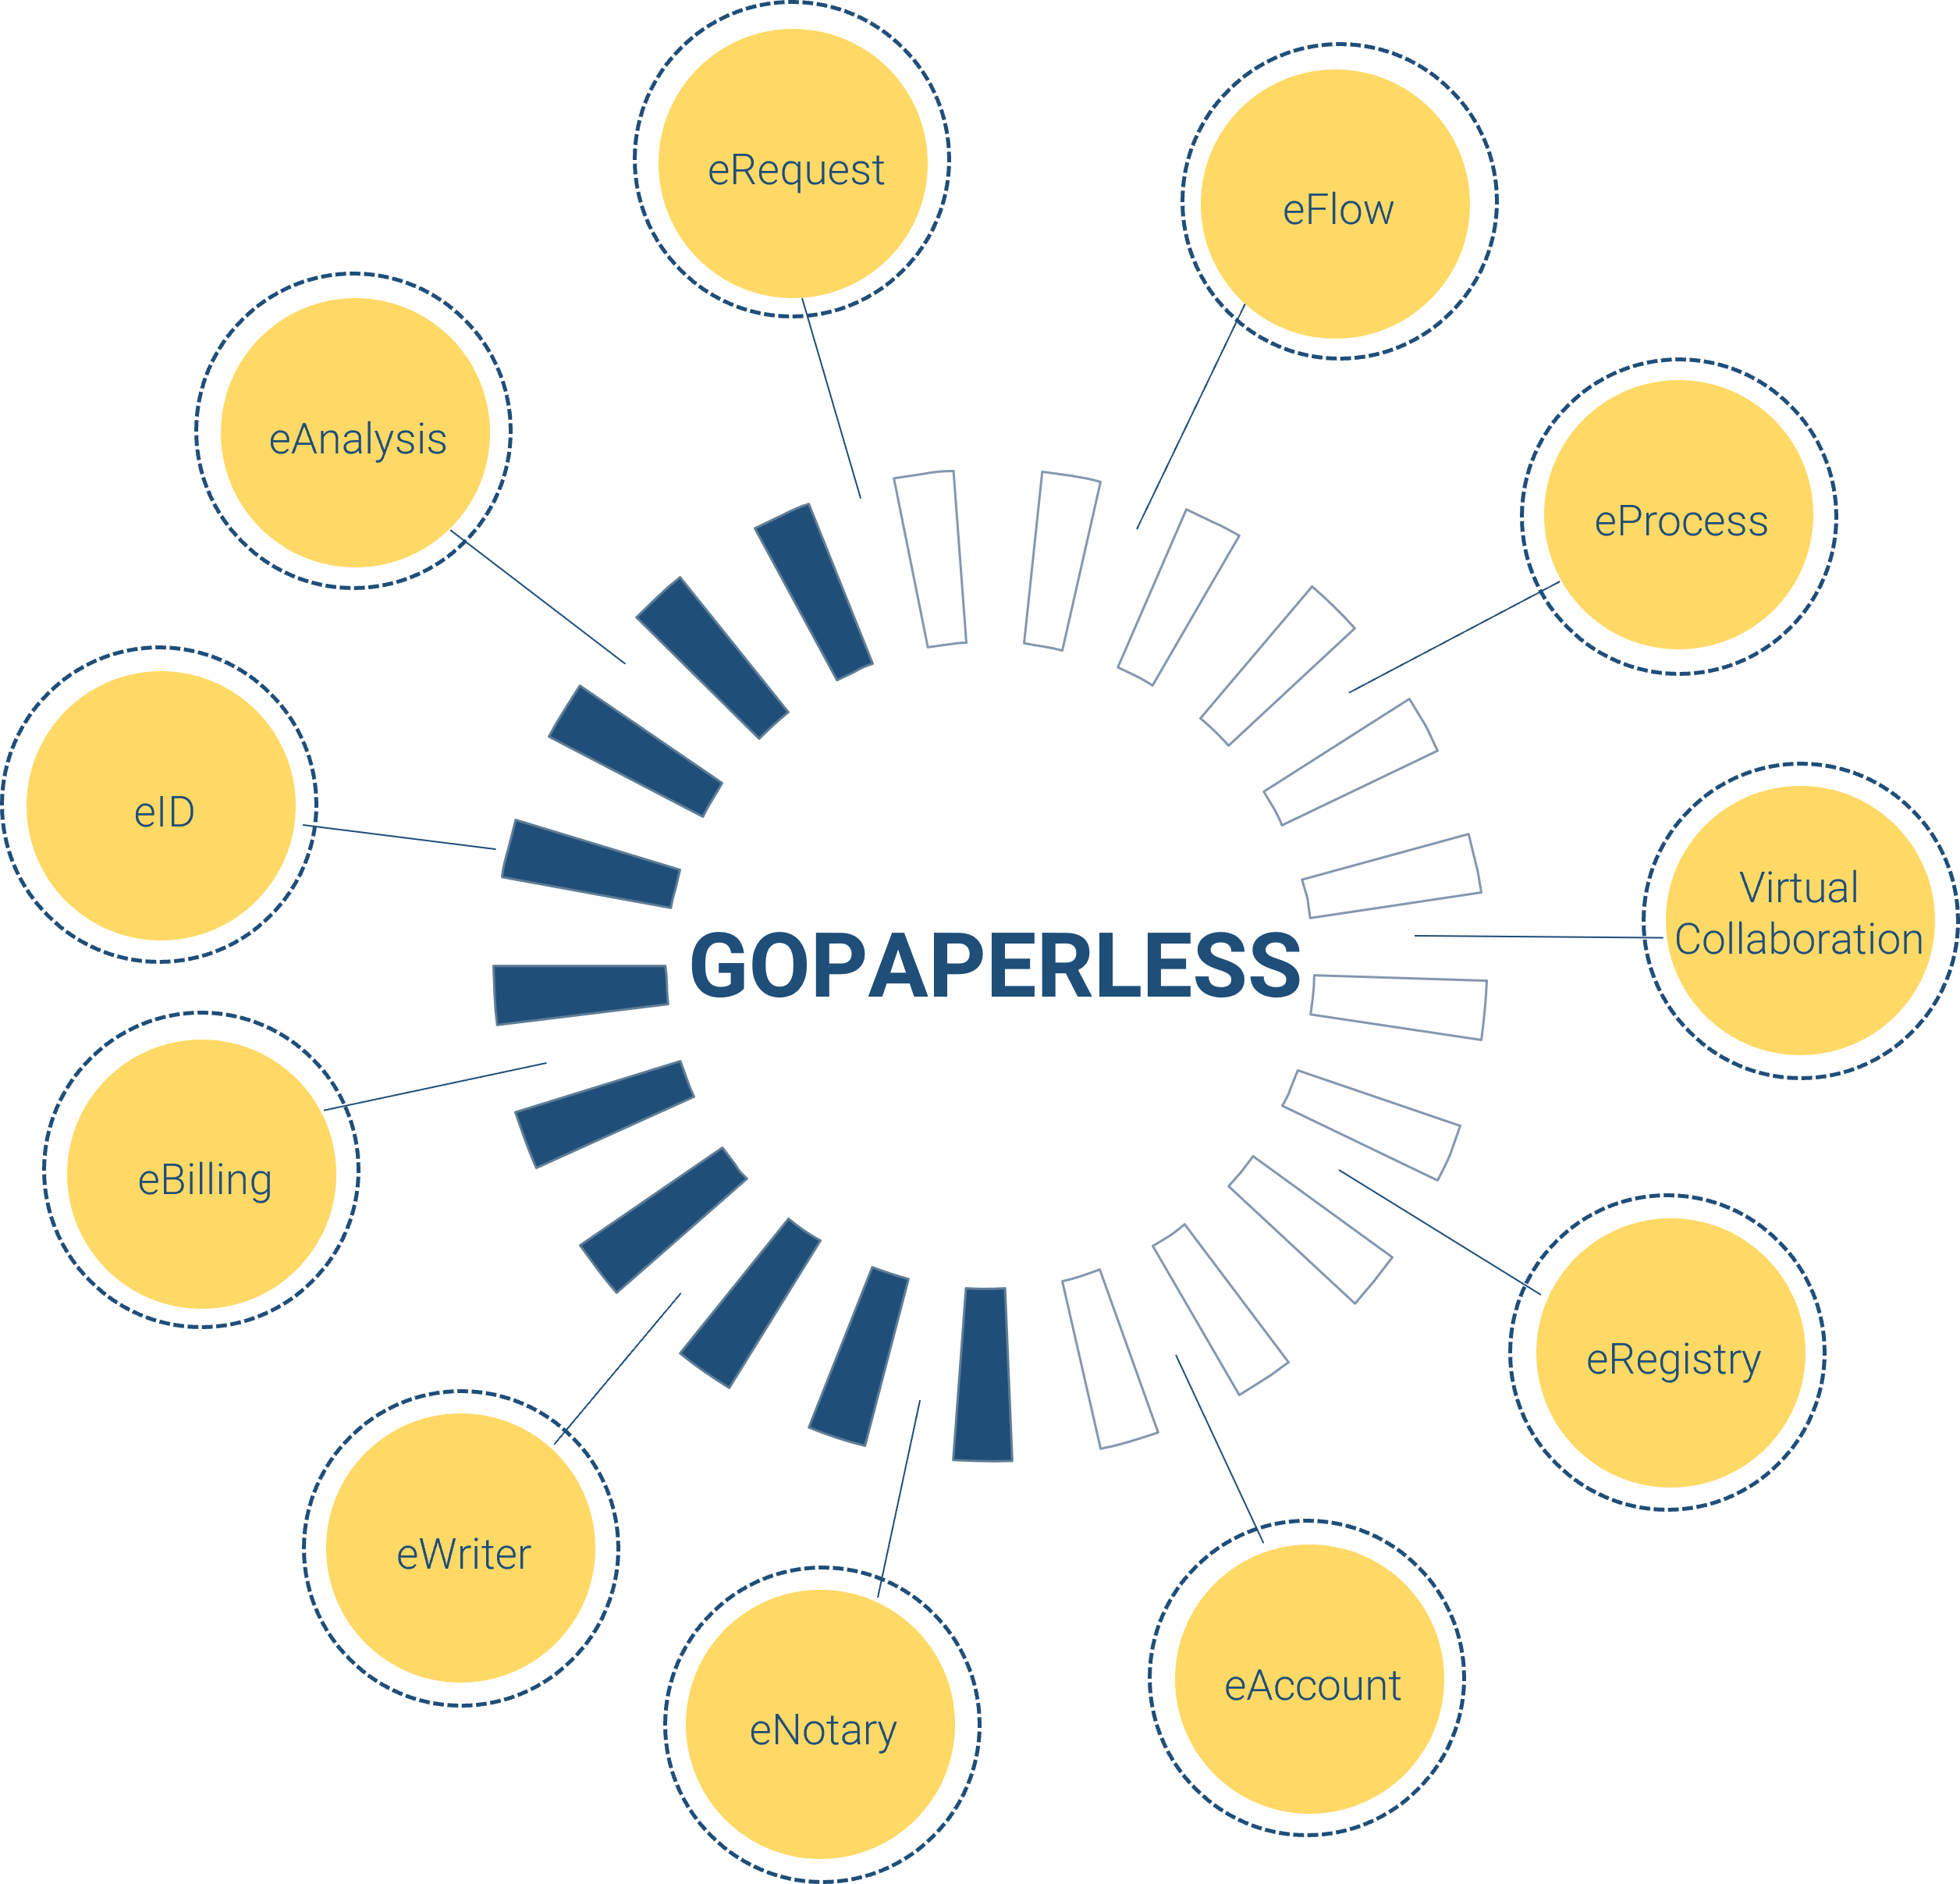
FULL PROCESS SIGNING PLATFORM
eAccount: Centralized account management subsystem
eRegistry: Service registration subsystem
eRequest: Ticket, ticket status management subsystem
eFlow: Subsystem for creating eForm and configuring workflow
eProcess: Subsystem for linking and publishing workflows
eID: Citizen’s identity information management subsystem
eNotary: Electronic notary subsystem
Virtual collaboration: Virtual collaboration module, allowing online contract negotiation, meetings, calls, chat
eAnalysis: Statistical analysis subsystem provides reports related to fields on the system
eBilling: Billing management subsystem
eWriter: Subsystem for editing and creating variables for documents with the purpose of exporting to another system to get the corresponding data variables

Slide 14





MOBILE-ID TECHNOLOGIES & SERVICES JOINT STOCK COMPANY
19 Dang Tien Dong street, An Phu ward, Thu Duc City, Ho Chi Minh City
028 3636 6015
info@mobile-id.vn

